Slide 1









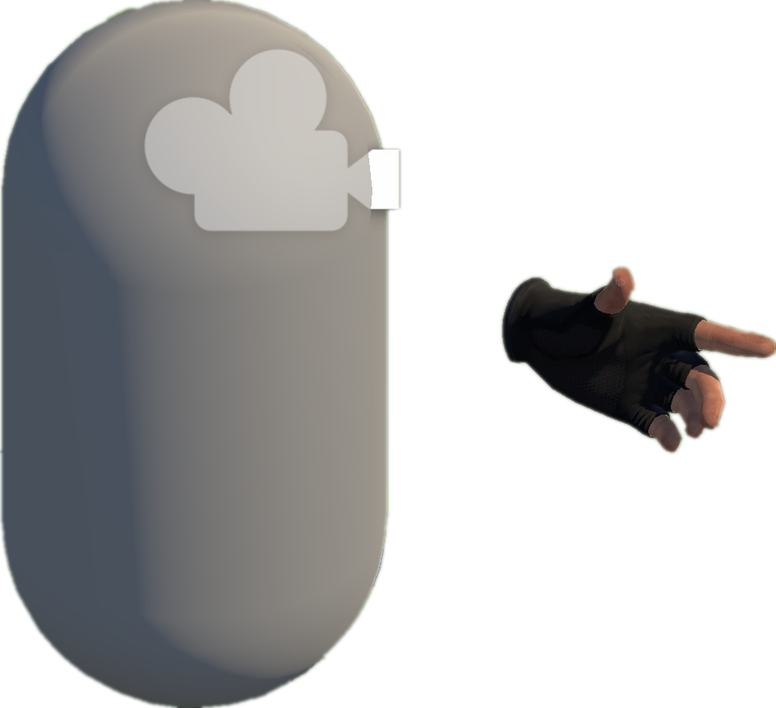




Heuristic rules & experiences
A
Project Collection
& Analysis (§ III-A)
Environment
B
Model Abstraction (§ III-B)
Static Analysis
Interactables
Dynamic Analysis
S1. Scene/prefab scan
Box
D1. Runtime state observation
Heuristic rules & experiences
Collect by Tags
S2. Script binding extraction
D2. Interaction flow tracing
Open Source
Repositories
Unity-based
VR Projects
S3. Interaction pattern identification
D3. Heuristic validation of task logic
Extract
abstraction models
Abstract Models
C
EAT Framework (§ III-C)
D
VRExplorer Testing (§ III-D)
3
Behavior Execution and Scene Exploration
Task Generator & Customized Task Model
Preliminary Scene Configuration
Implementation Interface
Camera
1
2
Parallel and serial combinations
Hand Controller
Base Action
Original Scene
Full Project
Collider
VRExplorer Agent
Inherit
Inherit
Grab Action
Trigger Action
Core Scripts
Bake NavMesh
Interaction & Scene Analysis
Autonomous Event Invocation
Grab
Base Entity
Trigger
Customizing Entity Interface Configuration
PFSM
Task Execution
Decision Making
Decision Making
Inherit
Inherit
Grabbable Entity
Triggerable Entity
Scene with NavMesh
(for navigation)
Scripts Implemented
Entity Interface
Task Execution
Autonomous
Event Invocation
Implement
Input Next Interactable
Output
Implement
Implement
XR Box
XR Joystick
Task Generator
Task Model
XR Button
Task Layer
Action Layer
Entity Layer
Mono Scripts
Unity Scene
Third Plugins
NavMesh Data
Entity Interface
C# Scripts File
GameObjects
Notes:
单击此处添加文本

